Slide 1
SOURCES OF HEAT IN MINES

Slide 2


Slide 3
Mines air-conditioning employs the processes like
  Cooling and
  Dehumidification.
Therefore, design of mine air-conditioning systems require estimating the heat generated by different sources in underground mines.
Heat is emitted into subsurface ventilation system from a variety of sources.
The potential sources of heat in mines are
Surface air entering the mine
Heat flow from exposed wall rock:
Heat due to auto-compression in shafts and near-vertical openings
High temperature of surface air entering the mine
Ground water
Machinery and lights, locomotives
Human metabolism
Oxidation
Blasting
Rock movement

Slide 4
High temperature of surface air entering the mine
Surface air entering the mine can carry with it some heat if the surface temperature is high as compared to the underground temperature.
Heat due to auto-compression in shafts and near-vertical openings
The temperature of air changes with change in pressure.
Compression of air increases air temperature and vice versa.
Because of the greater density of the compressed air, the pressure rise and so temperature rise much more (5 to 7 times) than for ventilation air.
There could be a transfer of heat from the compressed air line to the ventilation air.
Due to auto compression, potential energy in converted to thermal energy.
As the air descends the downcast shaft, it gets compressed by the weight of the shaft air-column approximately at the rate of 1.1 kPa per 100 m depth and its potential energy is converted to heat energy.

Slide 5
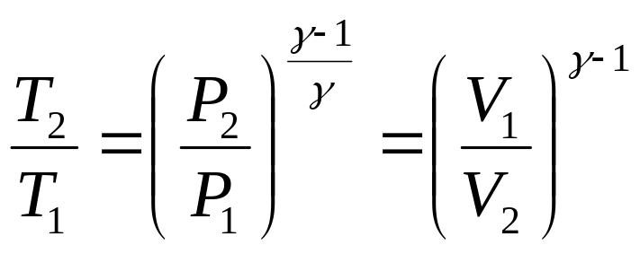

If no exchange (loss or gain) in the heat or moisture content of the air takes place in the shaft, the compression occurs adiabatically, with the temperature rise following the adiabatic law.
Where
T = temperature in K
= Cp/Cv = 1.404 for dry air (it varies slightly with the moisture content of air, but for mining purposes it can be taken as 1.4)
V = specific volume (volume of unit mass of air)
P = barometric pressure and
Subscripts 1 and 2 indicate the state of air at the shaft-top and shaft-bottom respectively.

Slide 6
Under similar assumptions, the rise in temp. due to auto compression can also be obtained by equating the potential energy with enthalpy change
dQ – dW = dH + dPE + dKE
Where
dQ = heat added to or removed from the section
dW = external work done on or by the air in the section
dH = change in enthalpy of the air across the section
dPE = change in potential energy of the air across the section = gdh
dKE = change in kinetic energy of the air across the section
Under the assumptions made,
As no heat is transferred, dQ = 0
As no work is done, dW = 0
As the flow is non-accelerative, dKE = 0
So that dH = - dPE
hg = ΔH = CpΔT
Where
ΔT = rise in temperature, K
ΔH = rise in enthalpy, J/kg
h = depth of shaft, m
Cp = specific heat of air in J/kgK

Slide 7
      H = mgh/1000
Where
m = mass of air, kg
g = acceleration due to gravity, m/s²
h = depth of shaft, m
H = increase in heat content, kJ/kg
The increase in heat due to auto compression of 1 kg of air passing 100 m vertically downcast shaft is given by:
H = (9.8 × 1 × 100)/1000 = 0.98 kJ/kg

Slide 8
Heat from rock
Heat flow from underground wall rock is a major contributing source to the rise in mine air temperature.
Amount of heat transferred from the rock, in a given mining condition, requires a knowledge of the thermal properties of rock.
Heat flows out of the hot core of the earth at almost a constant rate of 0.05 W/m² over most of the earth’s surface.
As a result, the temperature of the ground rock increases steadily as we go deeper down the earth’s crust.
The rate of increase of temperature with depth is called geothermic gradient.
Geothermic gradient varies from place to place and it dependent on the physical properties of the rock such as
  Thermal conductivity
  Specific heat and
  Density, these three govern the rate of heat transfer in the rock

Slide 9
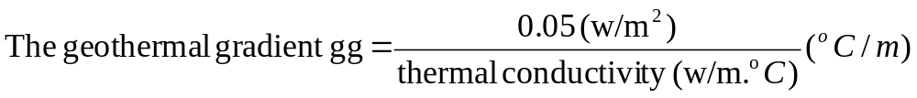
The typical values of geothermal gradients (°C/100m) are as follows:
Ontario, Canada 1.22
Hungary 5.00
KGF, India 1.10
Wit Waterstrand, South Africa 0.80
UK and Europe 1.00 – 3.00
Broken hill, NSW, Australia 1.97

Slide 10
The geothermic gradient is steeper, or the rise in temperature with depth faster for rocks of lower thermal conductivity such as coal-measure rocks than for rocks of higher thermal conductivity.
In most climates the ground temperature at a depth of 15 m is not affected by changes in surface air temperature, and this ground temperature is called virgin rock temperature.
This temperature remains constant throughout the year and is usually the average annual temperature at the surface.
It varies from place to place depending on the climate.
The geothermic gradient at any place is thus the rate of rise in temperature above this temperature.

Slide 11
Heat transfer from the rock to mine air is mainly through direct heat transfer from the exposed rock surface to the air.
When the rock surface is dry, the heat transfer is mainly through convection and raises the sensible heat of the air, but when the rock surface is wet a substantial amount of water evaporates into the air thus leading to both sensible and latent heat transfer.
Direct heat transfer from the rock to the mine air is governed by the rate of heat transfer within the rock mass and the heat transfer from the rock wall of the excavation to the mine air.
The rate of sensible heat transfer from the rock wall to the air is a linear function of the difference between the temperature of the rock wall and the mean air temperature as well as the coefficient of heat transfer
q = α (Ts - Ta)
Where
q = rate of heat transfer, i.e. amount of hat flow per unit area per unit time
α = coefficient of heat transfer and
Ts and Ta are the rock-wall and air temperatures respectively.

Slide 12
Ground water
All ground water, especially that from hot fissures and natural rock reservoirs, is a prolific source of heat in mine workings.
Since the water and heat both are derived from the surrounding rock or geothermic sources, the water temperature will approach or even exceed that of the rock.
The water transfers its heat to the mine air during evaporation, increasing the latent heat of the air.
The strata water oozes out almost at the virgin-rock temperature. The water cools rapidly by evaporation as soon as it is exposed to the mine air. by the time it reaches the sump, it may attain a temp. equal to or slightly higher than the return air temp.
The heat transfer through strata water = Cpw (Tv - T) per unit mass of water flowing out.
Where
Cpw = specific heat of water, Tv = virgin rock temperature and
T = temperature of water entering the sump
In a survey of seven hot mines, in the United States and Canada it was found that mine water added 20% of the total heat gained by the air.

Slide 13
Heat from man
Heat is produced by men through the process of metabolism.
Even a man at rest produces quite an appreciable quantity of heat by basal metabolism (when food is withheld for a specific length of time).
It is estimated that the heat produced by basal metabolism at 46.5 W per m² of body surface.
Average men have a body surface of 1.8-1.9 m² so that they have a basal metabolic rate of 84-88 W.
When doing hard work, the heat produced by the body is much more and sometimes it may be as much as 10 times than that produced by basal metabolism.
A typical average heat-generation rate thorough metabolism is around 200 or 300 W per person.
However, hard-working men can generate metabolic heat up to 400 or 500 W for short periods of time.

Slide 14
Heat produced by machinery
In highly mechanized mines, this can be a large source of heat.
Since the power losses and most of the work done are converted directly to heat or indirectly to heat through friction, nearly, all the energy consumption of machinery underground adds heat to the mine air.
Therefore, amount of heat generated by electric-powered machinery in a mine appears to equivalent to the electric power input.
Almost all the work done by face machinery for cutting, drilling, loading and transport is frictional except for the part of the work done against gravity in lifting matrial e.g. loading or conveying.
Hence, most of the power input to such machinery is converted to heat partly in the machine itself and partly through frictional work.
Most of the heat produced by the face machinery goes to raise the temp. of the air at the face.

Slide 15
Heat from lights
This becomes significant if carbide lamps are used.
It is estimated that a carbide lamp consuming 156 g of carbide per shift produces 96.5 WJ of heat and it may be as high as 204.7 W when the lamp burns at full brightness.
A candle produces 25-35 J, an electric cap lamp (two cell type), 2.6 J and an ordinary electric bulb, 40 J every second depending on the current and voltage.

Slide 16
Heat due to oxidation
Oxidation process involving the mineral, backfill, and timber in mines contribute heat to the mine air.
This is a major source of heat in coal mines, particularly in seams liable to spontaneous heating.
In coal mines, 80-85% of the heat added to the air can be traced to this source.
Heat due to oxidation is not appreciably high in metal mines where a small quantity of heat may be produced by the oxidation of timber.
In ore mines producing sulphide ores, oxidation of sulphides may add a considerable amount of heat to the air.
Heat due to oxidation of coal is 8.79 MJ/M3 of O2 absorbed while that for oxidation of pyrites is 18 MJ/m3.

Slide 17
Heat due to blasting
This can be of considerable magnitude.
Since over half and perhaps 90% of the energy released by the detonation of high explosive is liberated in the form of heat, blasting on occasion can be a significant heat source.
It is estimated that heat produced by blasting in a mine milling 101 600 tones per month to be 316.5 MJ/h on an average, but the actual heat produced in the hour of blast is of order of 5.3-6.3 GJ.
However, this heat is dissipated away by the ventilating air current before men return to work after blasting.
Also the amount of heat released depends on the type of explosive used in blasting.
Heat released varies from about 3700 kJ/kg for ANFO to 5800 kJ/kg for nitroglycerine.

Slide 18
Heat caused by rock movement
Movement of ground due to geologic causes or mining subsidence is another heat source.
Caving or colapse of waste or ore in stopes or abandoned areas is the most common cause of heat liberation due to ground movement.
It has been shown that the actual heat addition to the air on account of the movement of strata in coal mines is only 1 % of the total heat added to the air. But theoretically it should be around 9%.
This is believed to be due to most of the heat being dissipated in the broken rock mass itself.

Slide 19
PHYSIOLOGICAL EFFECTS
OF
HEAT AND HUMIDITY
ON THE MINER

Slide 20
‘Mine climate’ refers to the prevailing conditions of temperature, humidity and velocity of air in a mine.
In deep mines, intensively mechanized mines and working areas farther from shafts, climatic conditions deteriorate due to increase in temperature and humidity, influencing the health, safety and efficiency of the miners.
As temperature and humidity increases, accident rate increases and working efficiency and hence production decreases.

Slide 21
Human body employs a remarkable control system for regulating body heat and holding temp. nearly constant at 98.6 °F (37 °C).
This mechanism maintain a balance between the heat-loss and heat-gain to prevent harmful thermal effects (heat strain) to the body.
Metabolism is the source of all heat produced within the body.
At rest in a comfortable environment, due to oxidation and other chemical processes while digesting food, a person liberates heat of about 115 W, is termed basal metabolism.
In addition, 115 to 585 W or more of waste heat is produced during physical exertion.
Waste heat produced by the process of metabolism is dissipated through skin into the surrounding mine air by conventional heat-transfer processes:
  Convection,
  Radiation and/or
  Evaporation of sweat.

Slide 22
Small part of heat is given out through exhaled air during respiration.
A basic heat-balance equation is developed by the American Society of Heating, Refrigerating & Air-conditioning Engineers (ASHRAE), to express the heat changes in the human body.
Heat losses from the body are considered +ve and heat gains are –ve.
Since mechanical work (e.g. climbing a ladder) is accomplished by the body, it is taken as +ve and hence subtracted from metabolism to find the net body-heat production.
Work is –ve when potential energy is added, e. g. walking down steps.
Symbolically, heat balance for the human body can be represented as in fig.

Slide 23
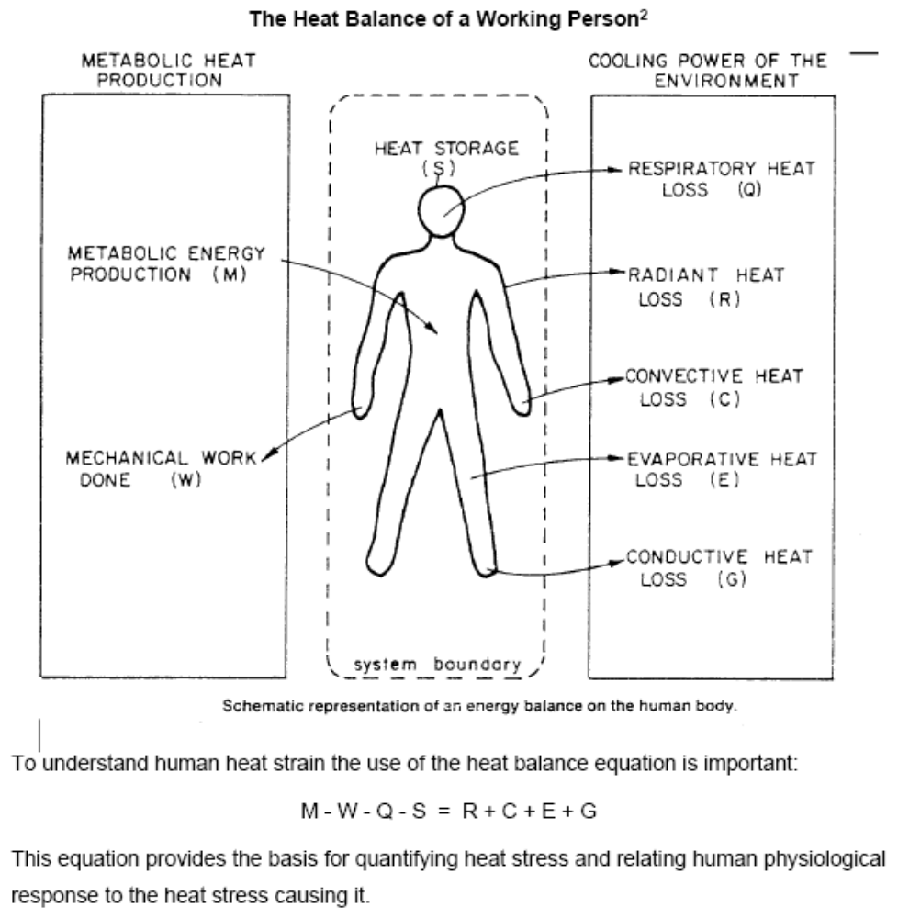

Slide 24
Effects and symptoms of heat illness/stress on miners
Heat stroke:
It is the most serious of heat disorders and 20 to 80% are fatal.
Due to failure of heat regulatory mechanism of the body
At body temp. more than 40 °C, sweating stops, leaving the skin hot, dry, and flushed.
The patient may sink into a coma.
Heat cramps:
They are the acute form of salt depletion.
Especially common among workers in hot factories and mines.
Symptoms are fatigue, dizziness and severe muscle pain, leading to stomach cramps.

Slide 25
Heat exhaustion:
Less severe but chronic.
Marked by fatigue, headaches, dizziness, blurred vision, and sometimes an inability to sweat.
Mental fatigue:
Due to under supply of blood to brain.
Symptoms are Carelessness, Rebellious attitude, Neglect to work
Other heat illnesses:
Heat fainting, the most common.
Heat retention
Dehydration

